Slide 1

Meissen in Europe
Porcelain Academy Meissen non-profit GmbH
X
Europe, Saxony, and the City of Meissen
Porcelain Academy Meissen non-profit GmbH
Europe is a continent with many countries and cultures.
Trade, science, art and education
connect the countries.
Notes:
Thank you very much for the invitation to the forum under the motto 'Dialogues between World Heritage and Civilization' here in Jingdezhen. I’m delighted to introduce the Meißen Porcelain Academy to you, a non-profit institution dedicated to preserving and revitalizing the craft of porcelain art internationally. The academy provides a platform for both tradition and modernity.

Slide 2
Meissen in Germany, in Saxony
Porcelain Academy Meissen non-profit GmbH
X
Germany is located in Central Europe.
The capital is Berlin.
Germany is a member of the European Union.
The Federal Republic of Germany consists of 16 federal states.
Notes:
Thank you very much for the invitation to the forum under the motto 'Dialogues between World Heritage and Civilization' here in Jingdezhen. I’m delighted to introduce the Meißen Porcelain Academy to you, a non-profit institution dedicated to preserving and revitalizing the craft of porcelain art internationally. The academy provides a platform for both tradition and modernity.

Slide 3
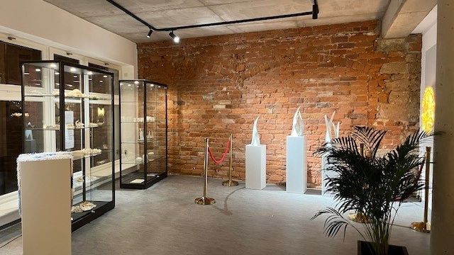
Porcelain between tradition and modernity

Slide 4
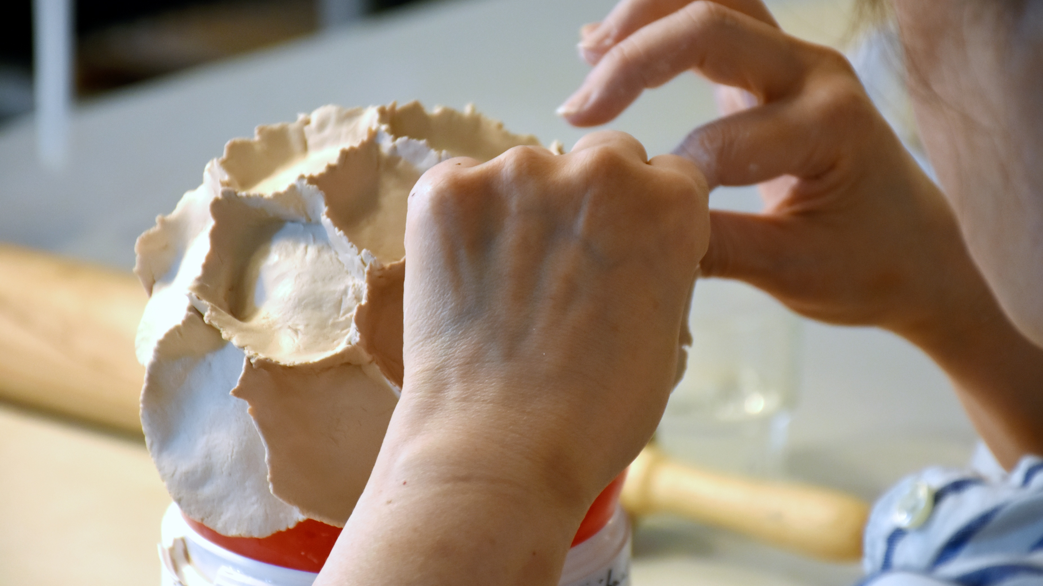
Workshops

Slide 5
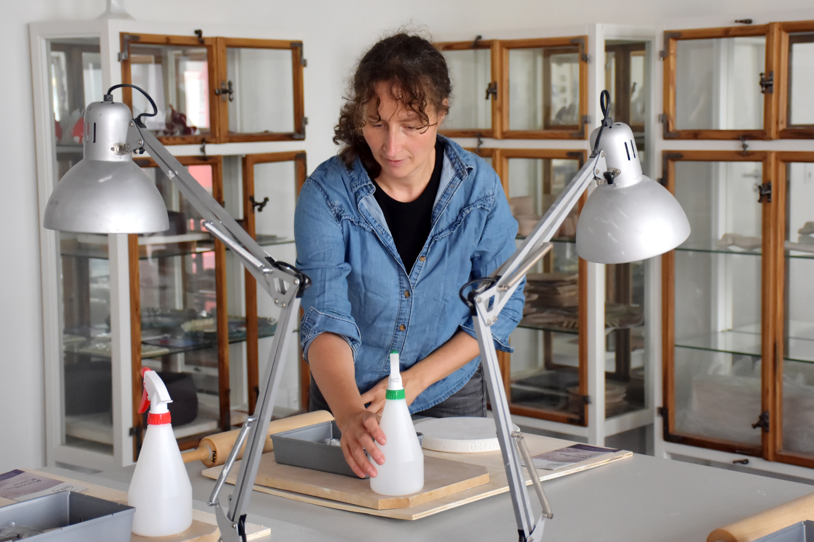
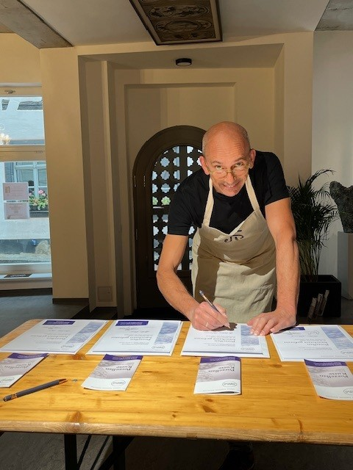
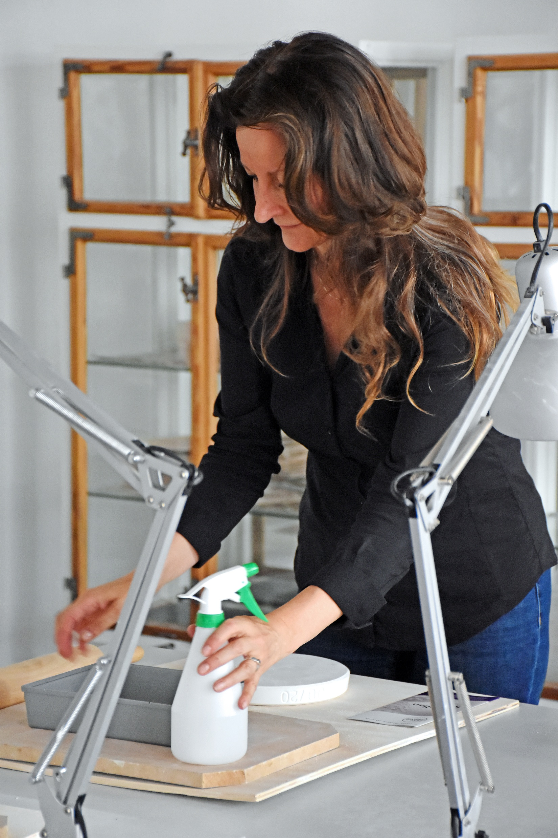
Offers and activities of the Academy:
Lectures and workshops on porcelain design,
'Artist in Residence', 'Student Exchange', scholarships for national
and international artists, exhibitions,
Presentations and cultural events
The INTERNATIONAL PORCELAIN AND CERAMICS FAIR
Notes:
"The academy is a prime example of how a regional tradition can have an impact beyond its area. Porcelain connects history, craftsmanship, and art. Through educational programs and exchanges, this tradition can remain interesting for future generations and an international audience." Currently, 30 porcelain artists worldwide collaborate with the academy through workshops, exhibitions, and lectures.

Slide 6
Learning - Researching - Creating at the Meissen Porcelain Academy non-profit GmbH
PAM stands for Porcelain Academy Meissen.
The academy promotes knowledge
transfer in the field of porcelain art.
It combines local tradition with
contemporary design.
It is aimed at artists and other
interested people.
International collaboration is an
important goal.
Learning: Understand techniques and put them into practice.
Exploring: Discover materials, glazes, and processes.
Creating: Bring your own artistic ideas to life.
Sharing: Exchange experiences with other artists.
Notes:
Learning: Understanding techniques and putting them into practice. Researching: Exploring materials, glazes, and processes. Creating: Bringing your own artistic ideas to life. Sharing: Exchanging experiences with other artists. Presenting: Making your work accessible to an audience.

Slide 7
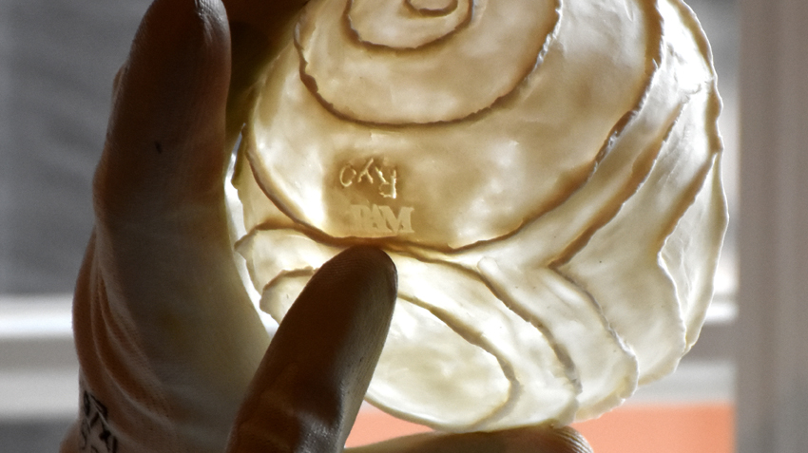
Teacher Guy van Leemput
Notes:
Das Akademie-Logo PAM.

Slide 8
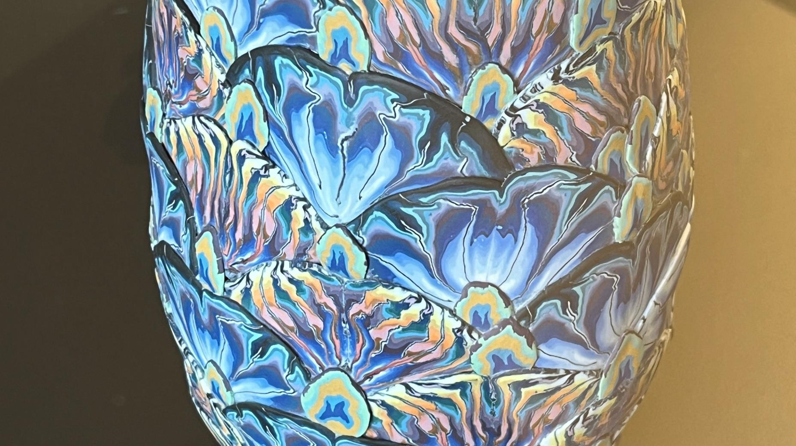
Judith de Vries

Slide 9
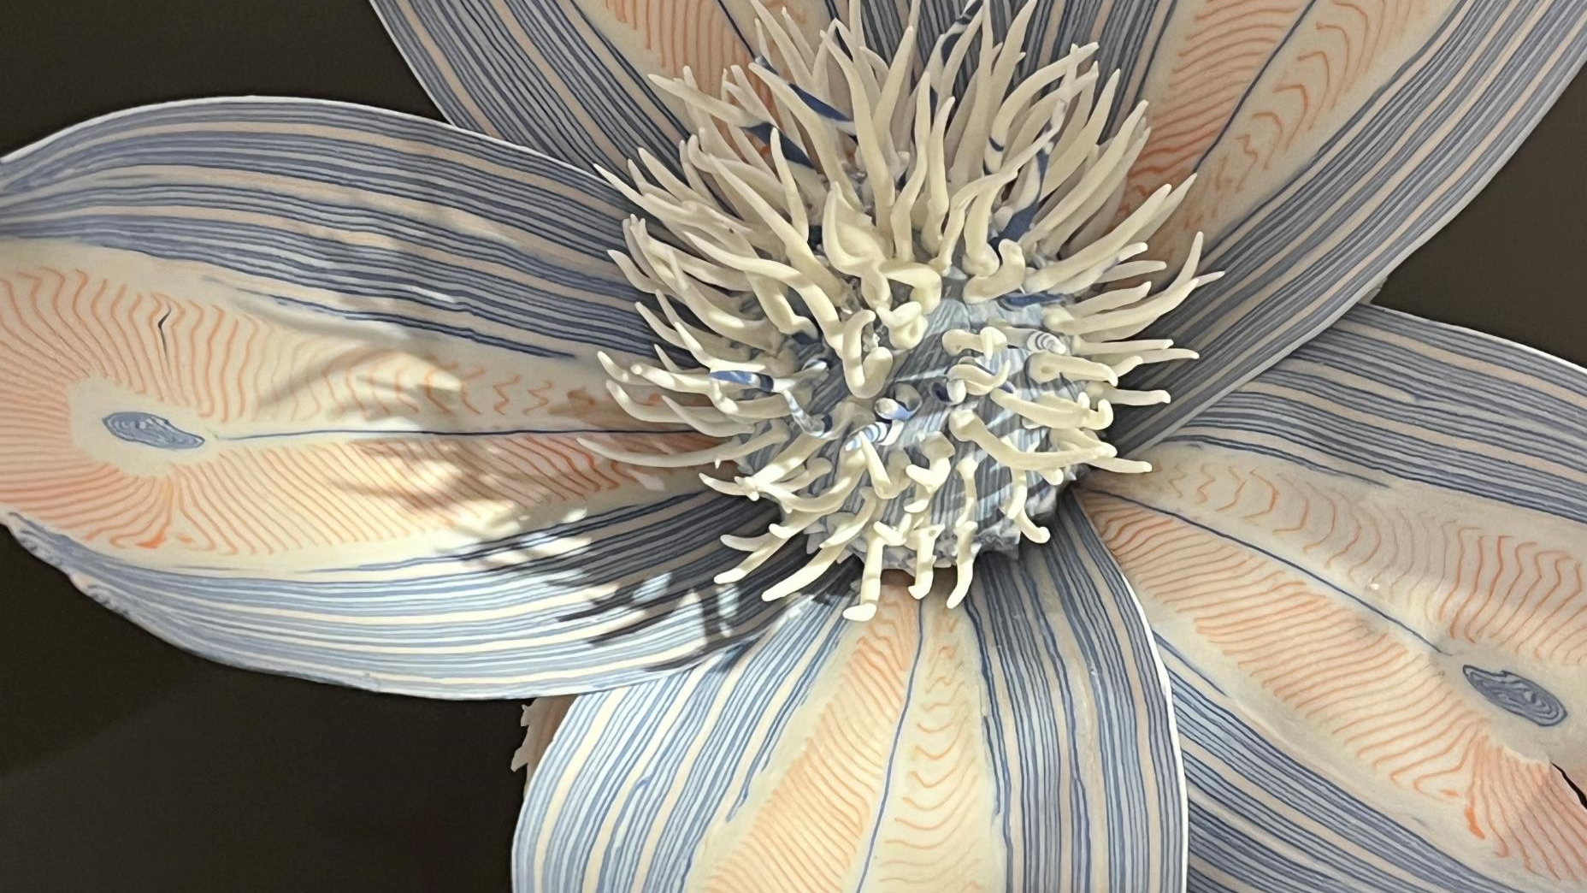
Francoise Joris
Notes:
A lively porcelain culture needs not only historical collections but also places where people can create themselves. That’s why the Porcelain Academy combines the tradition of Meissen with contemporary art, further education, and international exchange.

Slide 10
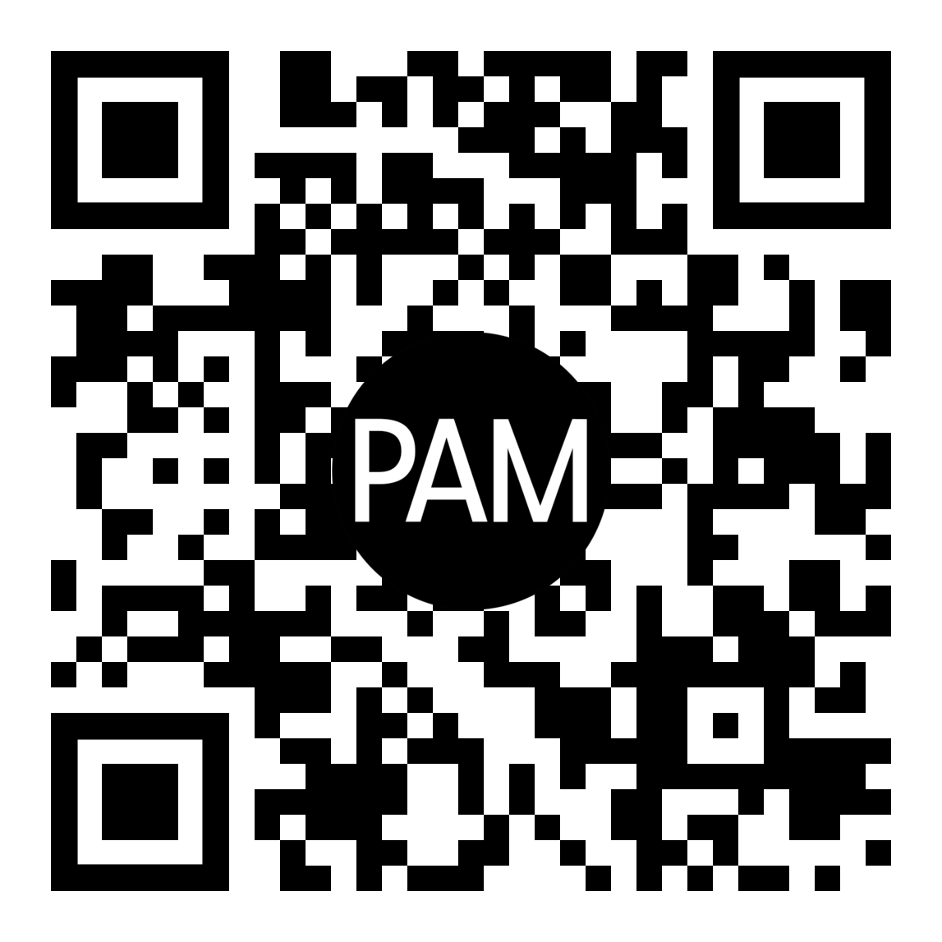
Porcelain Academy Meissen non-profit GmbH
We look forward to your visit and your applications.
Thank you for your attention.
www.porzellan-akademie.de
X
Notes:
Thank you very much for the invitation to the forum under the motto 'Dialogues between World Heritage and Civilization' here in Jingdezhen. I’m delighted to introduce the Meißen Porcelain Academy to you, a non-profit institution dedicated to preserving and revitalizing the craft of porcelain art internationally. The academy provides a platform for both tradition and modernity.

Slide 11
Sources:
porzellan-akademie.de
Geschichte des Porzellans in Meißen
Fotos:
Beate Pfefferkorn
Peggy Lange
Geschichte des Porzellans in Meißen

